Slide 1
Heat Transport
NE 591

Slide 2
Last Time
Developed analytical solutions for temperature profile
This time, we move from the analytical into the numerical framework

Slide 3
Review of Assumptions
Analytical solution required:
Steady-state solution
Temperature is axisymmetric
T is constant in Z
Thermal conductivity is independent of temperature
Temperature profile in the fuel is parabolic, linear profiles in gap, clad and coolant
For now, numerical solution we will assume:
Axisymmetric
Constant in Z

Slide 4
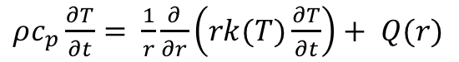
Simplify our heat conduction equation
Start with heat conduction equation
Assume axisymmetric (2D-rz)
Assume constant in z
This equation cannot
be solved analytically
$ρc_{p}\frac{∂T}{∂t}= \frac{1}{r}\frac{∂}{∂r}\left(rk(T)\frac{∂T}{∂t}\right)+ \frac{∂}{∂z}\left(k(T)\frac{∂T}{∂z}\right)+Q(r,z)$
$ρc_{p}\frac{∂T}{∂t}= \frac{1}{r}\frac{∂}{∂r}\left(rk(T)\frac{∂T}{∂t}\right)+ Q(r)$

Slide 5
For numerical solutions, deal with derivatives in space/time
Derivatives in time
Forward Euler’s method (explicit)
Backward Euler’s method (implicit)
Derivatives in space
Finite difference
Finite volume
Finite element

Slide 6
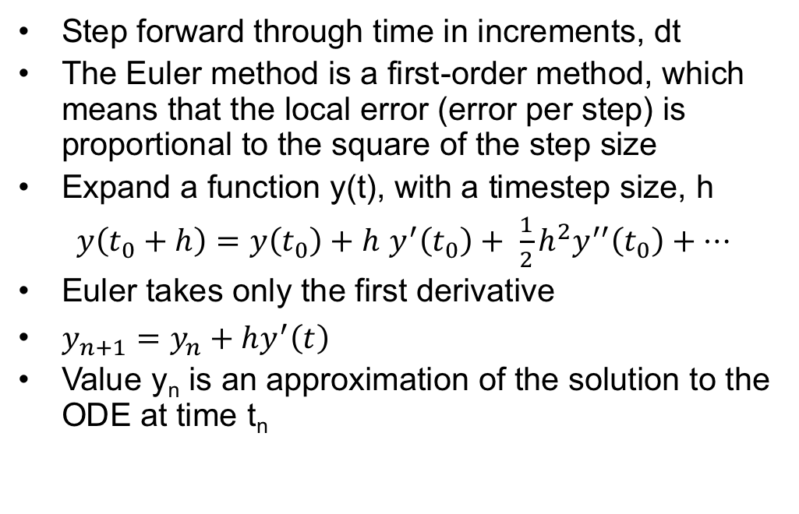
Forward Euler
Step forward through time in increments, dt
The Euler method is a first-order method, which means that the local error (error per step) is proportional to the square of the step size
Expand a function y(t), with a timestep size, h
$y\left(t_{0}+h\right)=y\left(t_{0}\right)+h$ $y^{′}\left(t_{0}\right)+ \frac{1}{2}h^{2}y^{′′}\left(t_{0}\right)+…$
Euler takes only the first derivative
$y_{n+1}=y_{n}+hy^{′}\left(t\right)$
Value y_{n} is an approximation of the solution to the ODE at time t_{n}

Slide 7
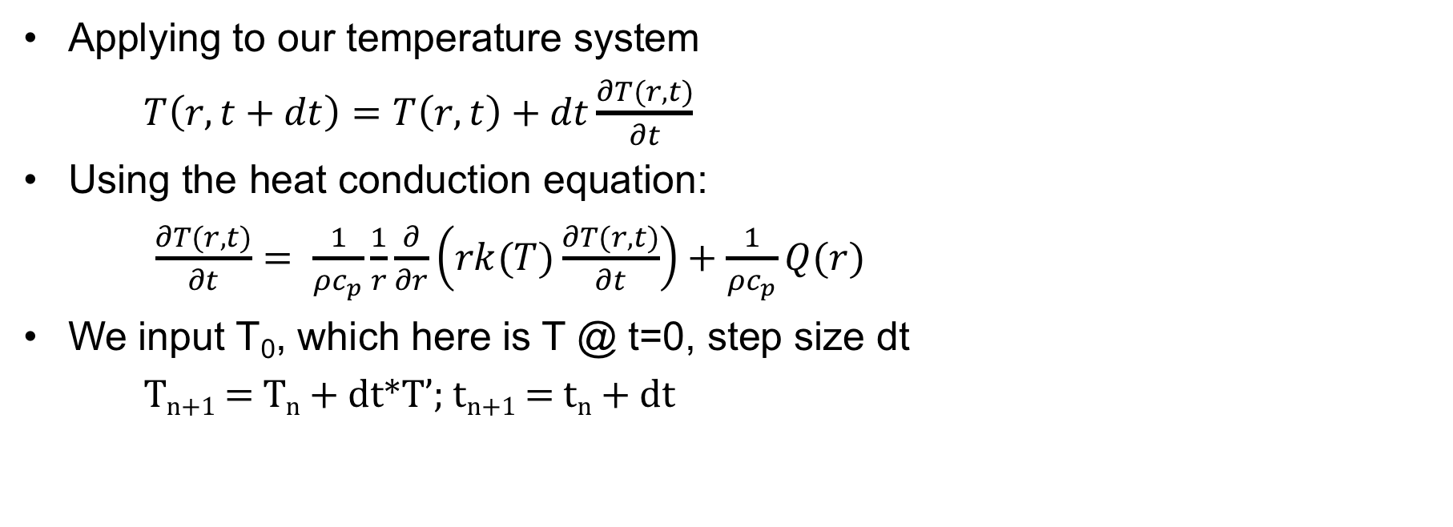
Forward Euler
Applying to our temperature system
$T\left(r,t+dt\right)=T\left(r,t\right)+dt\frac{∂T(r,t)}{∂t}$
Using the heat conduction equation:
$\frac{∂T(r,t)}{∂t}= \frac{1}{ρc_{p}}\frac{1}{r}\frac{∂}{∂r}\left(rk(T)\frac{∂T(r,t)}{∂t}\right)+\frac{1}{ρc_{p}}Q(r)$
We input T₀, which here is T @ t=0, step size dt
T_{n+1} = T_{n} + dt*T’; t_{n+1} = t_{n} + dt
T
t

Slide 8
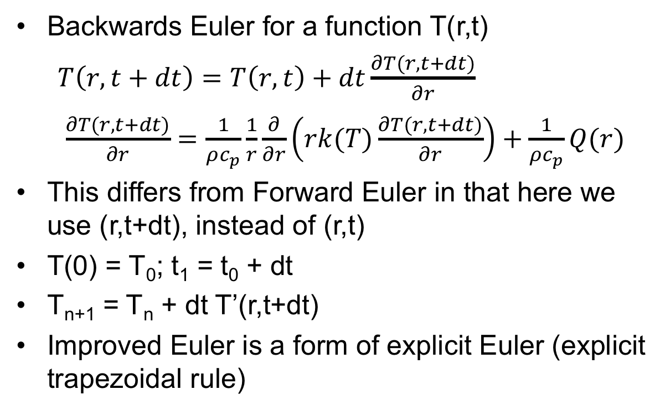
Backwards Euler
Backwards Euler for a function T(r,t)
$T\left(r,t+dt\right)=T\left(r,t\right)+dt\frac{∂T(r,t+dt)}{∂r}$
$\frac{∂T(r,t+dt)}{∂r}=\frac{1}{ρc_{p}}\frac{1}{r}\frac{∂}{∂r}\left(rk(T)\frac{∂T(r,t+dt)}{∂r}\right)+\frac{1}{ρc_{p}}Q(r)$
This differs from Forward Euler in that here we use (r,t+dt), instead of (r,t)
T(0) = T₀; t₁ = t₀ + dt
T_{n+1} = T_{n} + dt T’(r,t+dt)
Improved Euler is a form of explicit Euler (explicit trapezoidal rule)
T
t

Slide 9
Explicit vs Implicit
Forward Euler is explicit
Explicit methods calculate the state of a system at a later time from the state of the system at the current time
Can be unstable if step size is too much
Backwards Euler is implicit
Implicit methods find a solution by solving an equation involving both the current state of the system and a later state
Implicit require an extra computation and they can be much harder to implement
Implicit methods are used because many problems arising in practice are stiff, for which the use of an explicit method requires very small timesteps

Slide 10
Spatial resolution
To numerically solve in space, we need to discretize
Finite difference
convert differential equations into a system of equations that can be solved by matrix algebra techniques
Finite volume
volume integrals in a partial differential equation that contain a divergence term are converted to surface integrals, using the divergence theorem. These terms are then evaluated as fluxes at the surfaces of each finite volume
Finite element
subdivides a large system into smaller, simpler parts that are called finite elements, the equations that model these finite elements are then assembled into a larger system of equations that models the entire problem

Slide 11
Spatial resolution
Finite difference:
Advantages
Simple
Easy to code
Disadvantages
Difficult to model complex geometries
Difficult to model complex BCs
Only represents solution at points
Difficult to represent heterogeneous properties
No guarantee of convergence

